Slide 1

Fake News JEDI!
Aravind
Cliff
Daniel
Jenny
Jordan
Moneka
Narek
Naveen
Soheil

Slide 2


Slide 3

The Challenge!
Sniffing out FAKE news isn’t easy, because FAKERS:
Are smart and reactive
Change URL’s
Emulate Real News
Have Agendas
We need the Jedi power of AI to combat
the FAKERS

Slide 4
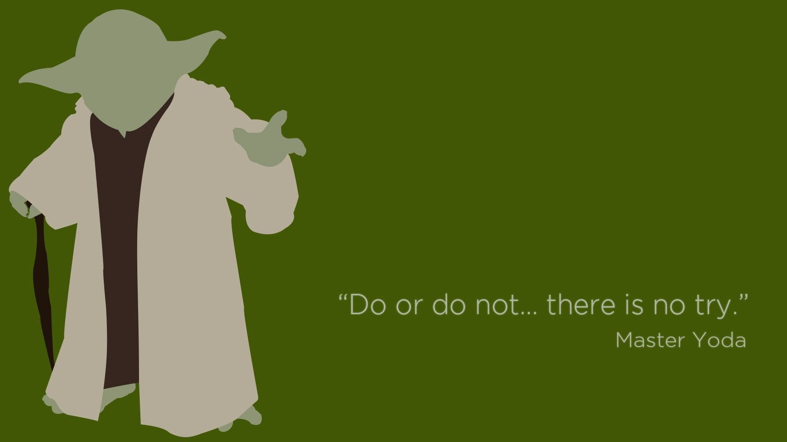
Our Solution
Multi Front Strategy
URL : Blacklist bad URL’s
Meta Data : Predictive Models
Headline : Text and Symbol Analytics
Content : Natural Language Processing

Slide 5

The Approach
Data
Fake: Kaggle + Facebook
Real: UCI ML Repository + Reuters
Analysis
Creating Training and Hold-out sets
Text analytics and NLP
Python Coded Feature Engineering
DataRobot Model building
Excel Visualization

Slide 6
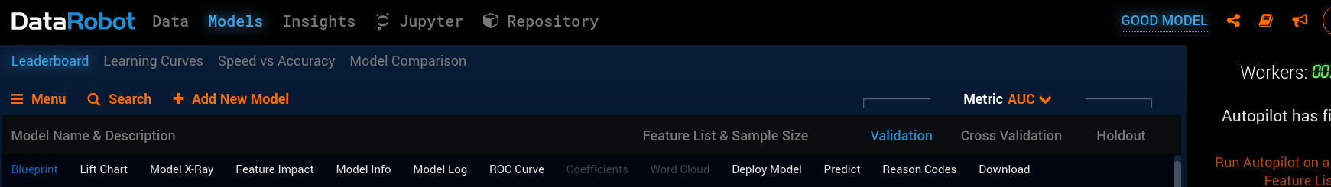
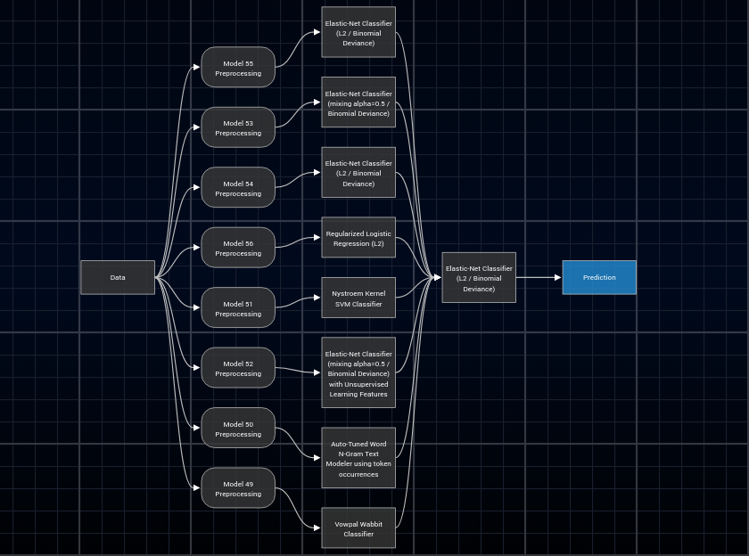
Modelling Tool

Slide 7
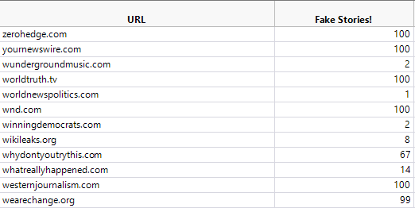
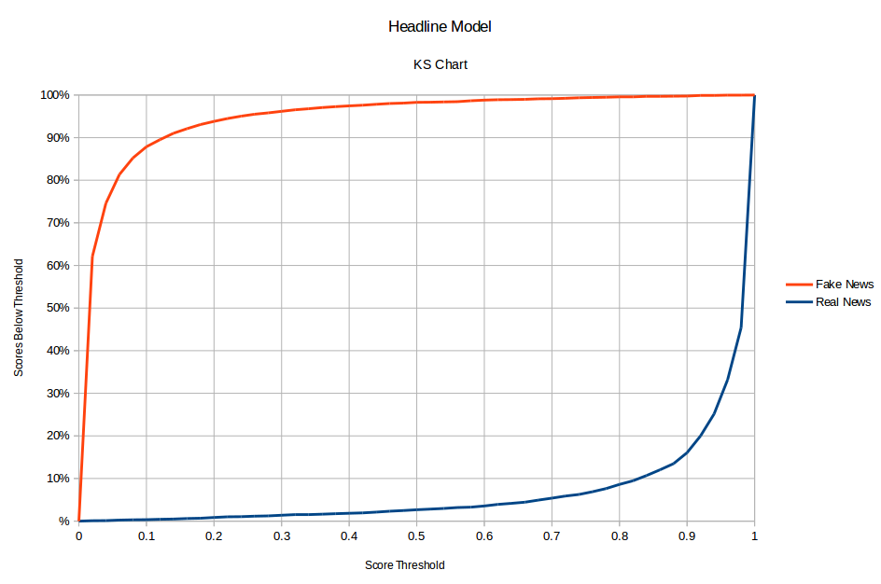
Our Results
Top Fake News URLs
Top Fake News Word Stems
Word Stem | Frequency
Hillari | 827
Trump | 304
Email | 273
FBI | 247

